Slide 1

How to get a job for Data scientist?
By Amy Guan, Kanjicai (Brock) Dong, John Boer

Slide 2


Summary
Due to the job the challenging markets, we are interested to look at the history datasets to see what we can learn from the historical datasets.

Slide 3
Questions
Technical / hard skills in general:
Soft skills in general:
Full-time / part time / contractor:
Geographical distribution:

Slide 4
Data
1) Data Scientist Job Market in the U.S. (Aug 2018)
An outlook at data science job market in the U.S. in Aug 2018.
2) 10000 Data Scientist Job Postings from the USA (Feb 2019)
Data Scientist job data from USA crawled via Job seeker
3) Data Jobs Listings – Glassdoor (Dec 2019)
160+k Data Related Job Listings Extracted from Glassdoor

Slide 5
Data Cleanup, Exploration & Analysis

Slide 6
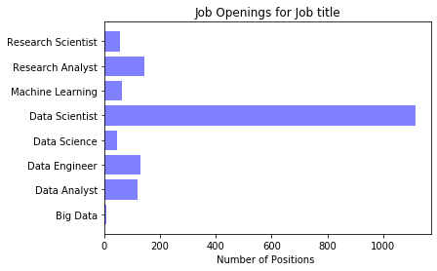
Positions comparison
AUG2018 DEC2019

Slide 7
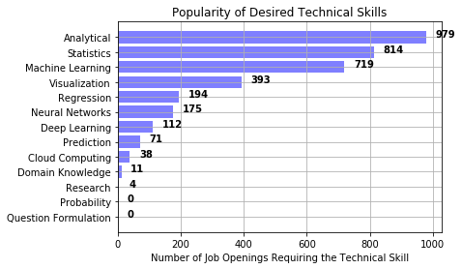
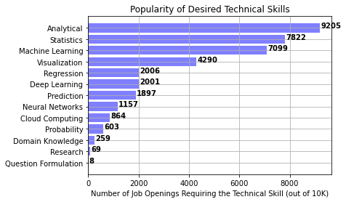
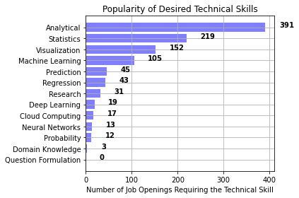
Job skills Comparison(Technical Skills)
AUG2018 FEB2019 DEC2019

Slide 8
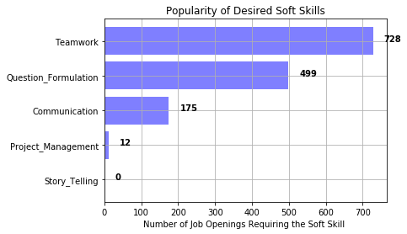
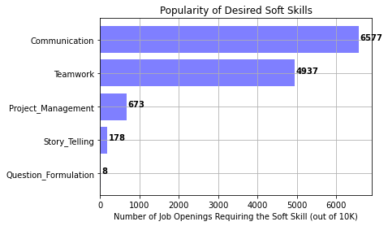
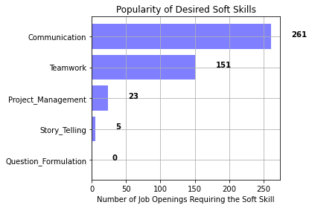
Job skills Comparison(Soft Skills)
AUG2018 FEB2019 DEC2019

Slide 9
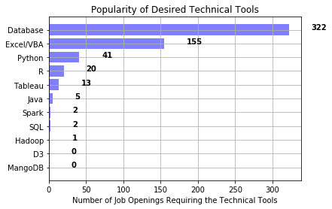
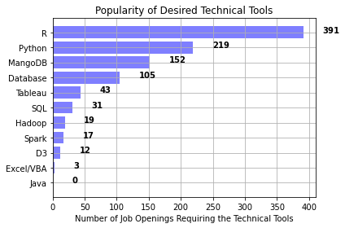
Job skills Comparison(Technical Tools)
AUG2018 FEB2019 DEC2019

Slide 10
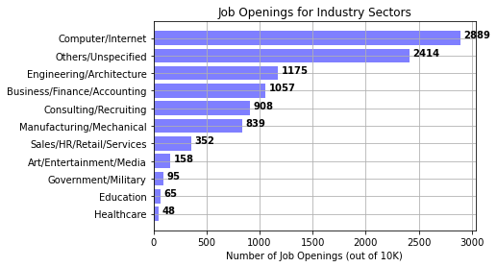
Top Skill desired by industries
FEB2019 DEC2019

Slide 12
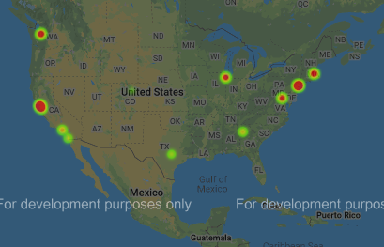
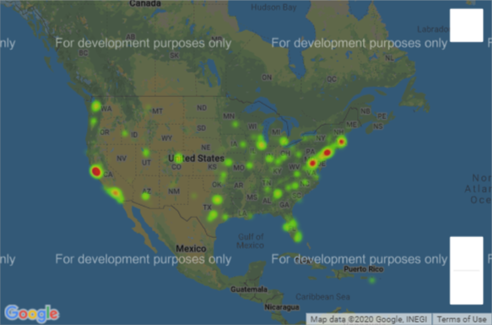
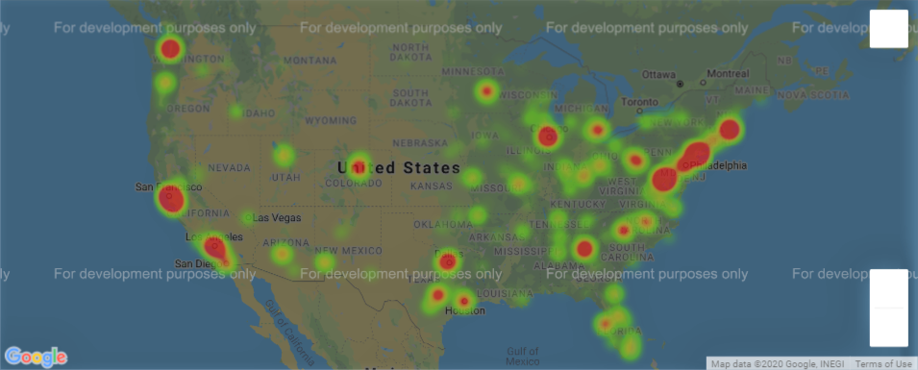
Maps for Job Locations in the US
(AUG)2018 (FEB)2019 (DEC)2019

Slide 13
Discussion & Conclusion

Slide 14
Post Mortem
Errors Codes
Key words search issues
Future works:
Pull more datasets and analyst the data, Choose the best data
Do Hypothesis testing for the three different datasets

Slide 15

Questions

